Slide 1
Data Encryption Standard,
Advanced Encryption Standard and Modes of Operation
Vietnam National University Ho Chi Minh City, University of Science
Department of Information Technology
Assoc. Prof. Trần Minh Triết
PhD. Trương Toàn Thịnh

Slide 2
Contents
Data Encryption Standard (DES)
Advanced Encryption Standard (AES)
  Guidance of AES128

Slide 3
Product Cipher
Encryption using only substitution or transposition is not safe (due to the nature of the language)
Consecutive use of simple encryption operations creates a more secure way of encrypting information
  Substitution combined with Substitution is more secure than one Substitution
  Transposition combined with Transposition is more secure than one Transposition
  Substitution combined with Transposition is much safer than using only one type of operation (replace or swap)
This is the prelude to modern encryption methods

Slide 4


Block-cipher
Data Path: Usually, the encryption process consists of several consecutive encryption cycles (rounds); Each cycle consists of many encryption operations
Key Schedule: From a secret-key, produce (with rule) key values ​​to be used in each encryption cycle (round key)
Key Schedule
Secret Key
Round Keys (Sub Keys)

Data Path
PlainText

Slide 5
Cipher architecture
Common architectures:
  Fiestel: for example, Blowfish, Camellia, CAST-128, DES, FEAL, KASUMI, LOKI97, Lucifer, MARS, MAGENTA, MISTY1, RC5, TEA, Triple DES, Twofish, and XTEA
  SPN: for example, Rijndael – AES, Anubis…
Data Encryption Standard: block-cipher
  Ideas: product cipher with key-size 56 bits and block-size: 64 bits
  IBM developed from Lucifer and published in 1975
  Chosen to be Federal Information Processing Standard-FIPS) in 1976
  Encryption and decryption algorithm published
  Mathematical and cryptographic basis of DES design: secret information

Slide 6



Feistel architecture - encryption
L_{i-1}
R_{i-1}
K_{i-1}
Round 1
…
⊕
f
Round i
…
Round Nr
L_{i}
R_{i}
L_{i} = R_{i-1}
R_{i} = L_{i-1} ⊕ f (R_{i-1}, K_{i-1})

Slide 7
Feistel architecture - decryption
L_{i}
R_{i}
K_{i}
Round Nr
…
⊕
f
Round i
…
Round 1
L_{i-1}
R_{i-1}
R_{i-1} = L_{i}
L_{i-1} = R_{i} ⊕ f (L_{i}, K_{i})

Slide 8
The Encryption Process of the DES
Plaintext
(64-bit)
IP: Initial Permutation
FP: Final Permutation
FP = IP⁻¹
Notes:
FP and IP have no cryptographic significance, only for loading data into and out of data blocks (in the mid-1970s hardware mechanism!!!)
Initial Permutation
Round 1
…
Round i
…
Round 16
Final Permutation (R₁₆,L₁₆)
Ciphertext
(64-bit)

Slide 9
Initial Permutation
IP
58 | 50 | 42 | 34 | 26 | 18 | 10 | 2
60 | 52 | 44 | 36 | 28 | 20 | 12 | 4
62 | 54 | 46 | 38 | 30 | 22 | 14 | 6
64 | 56 | 48 | 40 | 32 | 24 | 16 | 8
57 | 49 | 41 | 33 | 25 | 17 | 9 | 1
59 | 51 | 43 | 35 | 27 | 19 | 11 | 3
61 | 53 | 45 | 37 | 29 | 21 | 13 | 5
63 | 55 | 47 | 39 | 31 | 23 | 15 | 7
Example: 58th bit of x (input) becomes the 1st bit of IP(x) (output)
50th bit of x (input) becomes the 2nd bit of IP(x) (output)

Slide 10
Final Permutation
FP = IP⁻¹
40 | 8 | 48 | 16 | 56 | 24 | 64 | 32
39 | 7 | 47 | 15 | 55 | 23 | 63 | 31
38 | 6 | 46 | 14 | 54 | 22 | 62 | 30
37 | 5 | 45 | 13 | 53 | 21 | 61 | 29
36 | 4 | 44 | 12 | 52 | 20 | 60 | 28
35 | 3 | 43 | 11 | 51 | 19 | 59 | 27
34 | 2 | 42 | 10 | 50 | 18 | 58 | 26
33 | 1 | 41 | 9 | 49 | 17 | 57 | 25
Example: The 1st bit of x (input) becomes 58th bit of IP⁻¹(x) (output)
The 2nd bit of x (input) becomes 50th bit of IP⁻¹(x) (output)

Slide 11
Expansion
Table E: extend from 32 bits to 48 bits
Table of choosing bit
32 | 1 | 2 | 3 | 4 | 5
4 | 5 | 6 | 7 | 8 | 9
8 | 9 | 10 | 11 | 12 | 13
12 | 13 | 14 | 15 | 16 | 17
16 | 17 | 18 | 19 | 20 | 21
20 | 21 | 22 | 23 | 24 | 25
24 | 25 | 26 | 27 | 28 | 29
28 | 29 | 30 | 31 | 32 | 1
Example: 32nd bit of x (input) becomes the 1st bit of E(x) (output)

Slide 12
Function f of DES
Half block
(32 bit)
Expansion
48 bit
Sub Key
(48 bit)
⊕
S₁
S₂
S₃
S₄
S₅
S₆
S₇
S₈
Permutation

Slide 13
S-box
S₁
14 | 4 | 13 | 1 | 2 | 15 | 11 | 8 | 3 | 10 | 6 | 12 | 5 | 9 | 0 | 7
0 | 15 | 7 | 4 | 14 | 2 | 13 | 1 | 10 | 6 | 12 | 11 | 9 | 5 | 3 | 8
4 | 1 | 14 | 8 | 13 | 6 | 2 | 11 | 15 | 12 | 9 | 7 | 3 | 10 | 5 | 0
15 | 12 | 8 | 2 | 4 | 9 | 1 | 7 | 5 | 11 | 3 | 14 | 10 | 0 | 6 | 13
S₂
15 | 1 | 8 | 14 | 6 | 11 | 3 | 4 | 9 | 7 | 2 | 13 | 12 | 0 | 5 | 10
3 | 13 | 4 | 7 | 15 | 2 | 8 | 14 | 12 | 0 | 1 | 10 | 6 | 9 | 11 | 5
0 | 14 | 7 | 11 | 10 | 4 | 13 | 1 | 5 | 8 | 12 | 6 | 9 | 3 | 2 | 15
13 | 8 | 10 | 1 | 3 | 15 | 4 | 2 | 11 | 6 | 7 | 12 | 0 | 5 | 14 | 9
Example: B_{j} = b₁b₂b₃b₄b₅b₆ then S_{j}(B_{i}) = S_{j}[b₁b₆][b₂b₃b₄b₅]

Slide 14
S-box
S₃
10 | 0 | 9 | 14 | 6 | 3 | 15 | 5 | 1 | 13 | 12 | 7 | 11 | 4 | 2 | 8
13 | 7 | 0 | 9 | 3 | 4 | 6 | 10 | 2 | 8 | 5 | 14 | 12 | 11 | 15 | 1
13 | 6 | 4 | 9 | 8 | 15 | 3 | 0 | 11 | 1 | 2 | 12 | 5 | 10 | 14 | 7
1 | 10 | 13 | 0 | 6 | 9 | 8 | 7 | 4 | 15 | 14 | 3 | 11 | 5 | 2 | 12
S₄
7 | 13 | 14 | 3 | 0 | 6 | 9 | 10 | 1 | 2 | 8 | 5 | 11 | 12 | 4 | 15
13 | 8 | 11 | 5 | 6 | 15 | 0 | 3 | 4 | 7 | 2 | 12 | 1 | 10 | 14 | 9
10 | 6 | 9 | 0 | 12 | 11 | 7 | 13 | 15 | 1 | 3 | 14 | 5 | 2 | 8 | 4
3 | 15 | 0 | 6 | 10 | 1 | 13 | 8 | 9 | 4 | 5 | 11 | 12 | 7 | 2 | 14

Slide 15
S-box
S₅
2 | 12 | 4 | 1 | 7 | 10 | 11 | 6 | 8 | 5 | 3 | 15 | 13 | 0 | 14 | 9
14 | 11 | 2 | 12 | 4 | 7 | 13 | 1 | 5 | 0 | 15 | 10 | 3 | 9 | 8 | 6
4 | 2 | 1 | 11 | 10 | 13 | 7 | 8 | 15 | 9 | 12 | 5 | 6 | 3 | 0 | 14
11 | 8 | 12 | 7 | 1 | 14 | 2 | 13 | 6 | 15 | 0 | 9 | 10 | 4 | 5 | 3
S₆
12 | 1 | 10 | 15 | 9 | 2 | 6 | 8 | 0 | 13 | 3 | 4 | 14 | 7 | 5 | 11
10 | 15 | 4 | 2 | 7 | 12 | 9 | 5 | 6 | 1 | 13 | 14 | 0 | 11 | 3 | 8
9 | 14 | 15 | 5 | 2 | 8 | 12 | 3 | 7 | 0 | 4 | 10 | 1 | 13 | 11 | 6
4 | 3 | 2 | 12 | 9 | 5 | 15 | 10 | 11 | 14 | 1 | 7 | 6 | 0 | 8 | 13

Slide 16
S-box
S₇
4 | 11 | 2 | 14 | 15 | 0 | 8 | 13 | 3 | 12 | 9 | 7 | 5 | 10 | 6 | 1
13 | 0 | 11 | 7 | 4 | 9 | 1 | 10 | 14 | 3 | 5 | 12 | 2 | 15 | 8 | 6
1 | 4 | 11 | 13 | 12 | 3 | 7 | 14 | 10 | 15 | 6 | 8 | 0 | 5 | 9 | 2
6 | 11 | 13 | 8 | 1 | 4 | 10 | 7 | 9 | 5 | 0 | 15 | 14 | 2 | 3 | 12
S₈
13 | 2 | 8 | 4 | 6 | 15 | 11 | 1 | 10 | 9 | 3 | 14 | 5 | 0 | 12 | 7
1 | 15 | 13 | 8 | 10 | 3 | 7 | 4 | 12 | 5 | 6 | 11 | 0 | 14 | 9 | 2
7 | 11 | 4 | 1 | 9 | 12 | 14 | 2 | 0 | 6 | 10 | 13 | 15 | 3 | 5 | 8
2 | 1 | 14 | 7 | 4 | 10 | 8 | 13 | 15 | 12 | 9 | 0 | 3 | 5 | 6 | 11

Slide 17
Permutation table
P
16 | 7 | 20 | 21
29 | 12 | 28 | 17
1 | 15 | 23 | 26
5 | 18 | 31 | 10
2 | 8 | 24 | 14
32 | 27 | 3 | 9
19 | 13 | 30 | 6
22 | 11 | 4 | 25
Notes:
Input of 32 bits (includes 8 S-box, each S-box has 4 bits)
Output 32 bits are permuted
Example: the 1st bit of P(x) (output) is 16th bit of x (input)

Slide 18
Key Schedule
Bit rotation operation
  <<<: Rotate to the left
  >>>: Rotate to the right
With subkey in {1, 2, 9, 16}: rotate to the left one position
With remaining subkey: rotate to the left two positions
<<<
<<<
<<<
<<<
PC1
PC2
PC2
PC2
PC2
Key (64 bits)
<<<
<<<
<<<
<<<
Subkey 1 (48 bits)
…
Subkey 2 (48 bits)
Subkey 15 (48 bits)
Subkey 16 (48 bits)

Slide 19
Permutations in Key Schedule
PC-1
57 | 49 | 41 | 33 | 25 | 17 | 9
1 | 58 | 50 | 42 | 34 | 26 | 18
10 | 2 | 59 | 51 | 43 | 35 | 27
19 | 11 | 3 | 60 | 52 | 44 | 36
63 | 55 | 47 | 39 | 31 | 23 | 15
7 | 62 | 54 | 46 | 38 | 30 | 22
14 | 6 | 61 | 53 | 45 | 37 | 29
21 | 13 | 5 | 28 | 20 | 12 | 4
PC-2
14 | 17 | 11 | 24 | 1 | 5
3 | 28 | 15 | 6 | 21 | 10
23 | 19 | 12 | 4 | 26 | 8
16 | 7 | 27 | 20 | 13 | 2
41 | 52 | 31 | 37 | 47 | 55
30 | 40 | 51 | 45 | 33 | 48
44 | 49 | 39 | 56 | 34 | 53
46 | 42 | 50 | 36 | 29 | 32
_{Choose 56 bits}
(leave 8, 16, 24, 32, 40, 48, 56, 64)
_{Choose 48 bits}
(leave 9, 18, 22, 25, 35, 38, 43, 54)
Example: 50th bit of x (input) becomes the 1st bit of PC-1(x) (output)
Explain: 57 = 8 × 7 + 1 → 50 = 57 - 7

Slide 20
Comments
4 weak keys:
  All bits 0
  All bits 1
  ½ are bit 0 (consecutive), ½ are bit 1 (consecutive)
12 semi-weak keys
  Property: Encrypt_{k} (P) = P
  Form of such key: 7 bit 0 (consecutive), 7 bit 1 (consecutive)
Complement key
  Encrypt_{k}(P) = C → Encrypt_{k*}(P*) = C*
  x* is formed by reversing bits of x

Slide 21
Pseudocode DES
Encryption(K, M) // |K| = 56 and |M| = 64
  (K₁, …, K₁₆) ← CreateSubKey(K) // |K_{i}| = 48
  M ← IP(M)
  M → L₀ || R₀
  Loop r = 1, …, 16
    L_{r} ← R_{r-1}; R_{r} ← f(K_{r}, R_{r-1}) ⊕ L_{r-1}
  C ← FP(L₁₆ || R₁₆)
  Return C
CreateSubKey(K) // |K| = 56 bits
  K ← PC-1(K)
  K → C₀ || D₀
  Loop r = 1, …, 16
    If r ∈ {1, 2, 9, 16} then j ← 1, else j ← 2
    C_{r} ← C_{r-1} <<< j; D_{r} ← D_{r-1} <<< j
    K_{r} ← PC-2(C_{r} || D_{r})
  Return (K₁, …, K₁₆)

Slide 22
Rijndael method
Rijndael method proposed by Vincent Rijmen and Joan Daeman
The National Institute of Standards and Technology (NIST) has adopted it as the Advanced Encryption Standard since October 2, 2000.
The block cipher method has a flexible block size and key cipher with values ​​of 128, 192 or 256 bits.
This method is suitable for applications on a variety of systems from smart cards to personal computers.

Slide 23
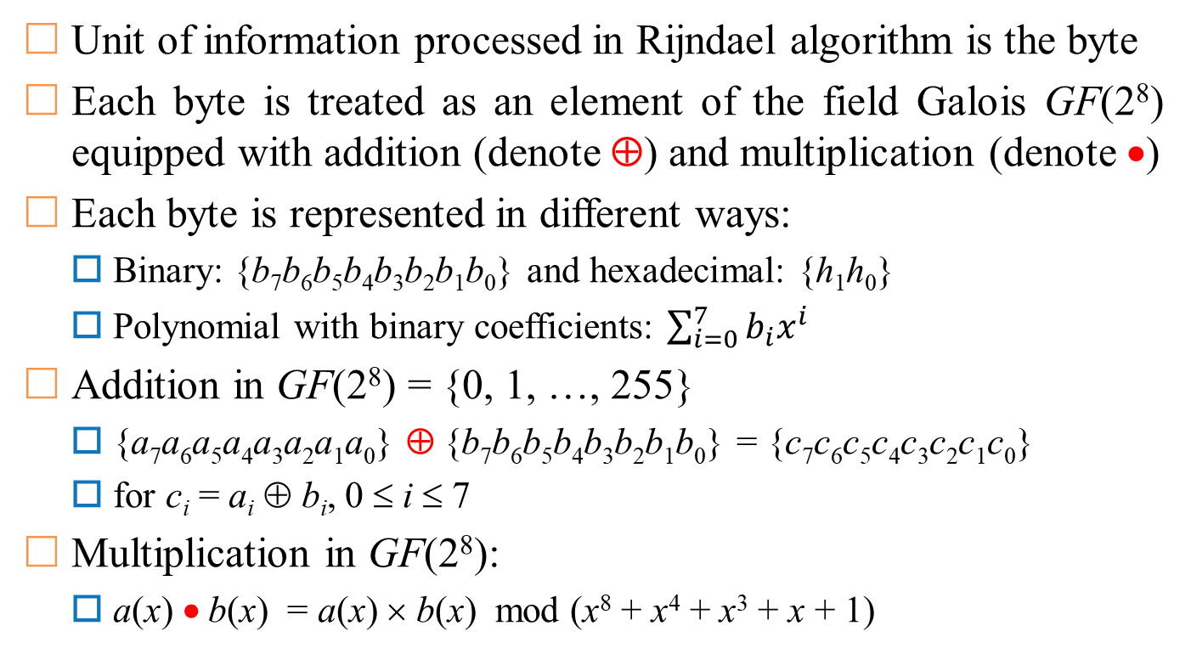
Some Math Concepts
Unit of information processed in Rijndael algorithm is the byte
Each byte is treated as an element of the field Galois GF(2⁸) equipped with addition (denote ⊕) and multiplication (denote •)
Each byte is represented in different ways:
  Binary: {b₇b₆b₅b₄b₃b₂b₁b₀} and hexadecimal: {h₁h₀}
  Polynomial with binary coefficients: $\sum_{i=0}^{7}{b_{i}x^{i}}$
Addition in GF(2⁸) = {0, 1, …, 255}
  {a₇a₆a₅a₄a₃a₂a₁a₀} ⊕ {b₇b₆b₅b₄b₃b₂b₁b₀} = {c₇c₆c₅c₄c₃c₂c₁c₀}
  for c_{i} = a_{i} ⊕ b_{i}, 0 ≤ i ≤ 7
Multiplication in GF(2⁸):
  a(x) • b(x) = a(x) × b(x) mod (x⁸ + x⁴ + x³ + x + 1)

Slide 24
Some Math Concepts
Example of multiplication of {53} = 01010011 & {CA} = 11001010
  (x⁶ + x⁴ + x + 1) • (x⁷ + x⁶ + x³ + x)
  = x¹³ + x¹² + x¹¹ + x¹⁰ + x⁹ + x⁸ + x⁶ + x⁵ + x⁴ + x³ + x² + x mod x⁸ + x⁴ + x³ + x + 1
  = 1
  = {01}
Example of addition of {53} = 01010011 & {CA} = 11001010
  (x⁶ + x⁴ + x + 1) ⊕ (x⁷ + x⁶ + x³ + x)
  = x⁷ + x⁴ + x³ + 1
  = {99}
https://en.wikipedia.org/wiki/Finite_field_arithmetic

Slide 25
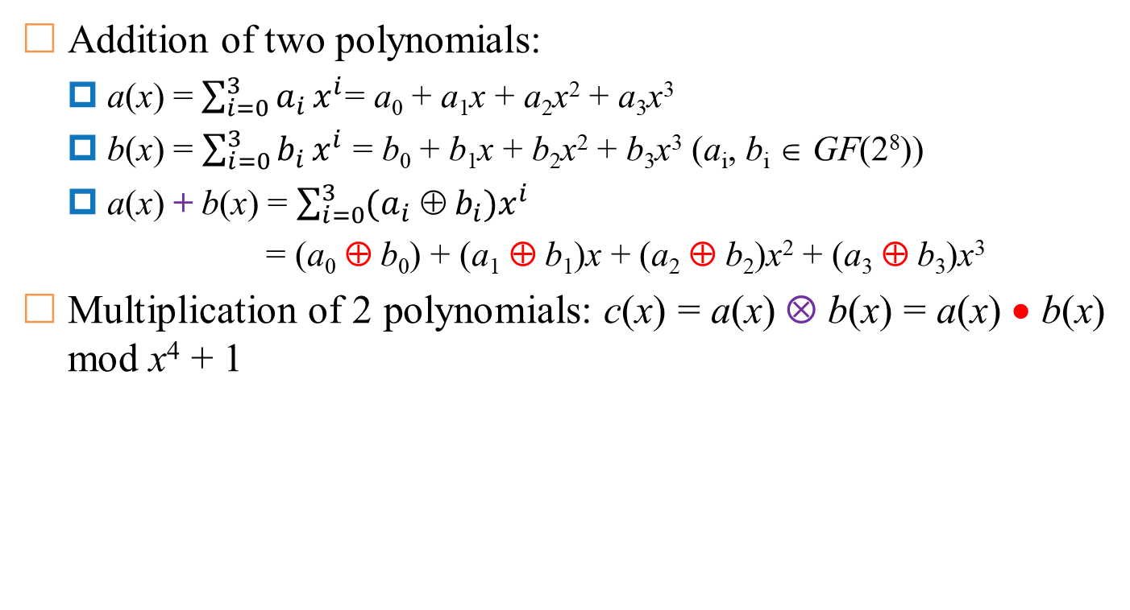
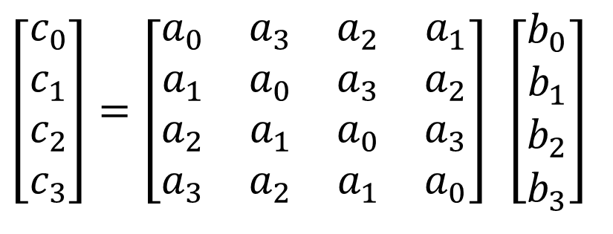
Polynomials with coefficients in GF(2⁸)
Addition of two polynomials:
  a(x) = $\sum_{i=0}^{3}{a_{i}}x^{i}$= a₀ + a₁x + a₂x² + a₃x³
  b(x) = $\sum_{i=0}^{3}{b_{i}}x^{i}$ = b₀ + b₁x + b₂x² + b₃x³ (a_{i}, b_{i} ∈ GF(2⁸))
  a(x) + b(x) = $\sum_{i=0}^{3}{(a_{i} ⊕ b_{i}})x^{i}$
  = (a₀ ⊕ b₀) + (a₁ ⊕ b₁)x + (a₂ ⊕ b₂)x² + (a₃ ⊕ b₃)x³
Multiplication of 2 polynomials: c(x) = a(x) ⊗ b(x) = a(x) • b(x) mod x⁴ + 1
$$\begin{matrix}\left[\begin{matrix}c_{0} \\ c_{1} \\ c_{2} \\ c_{3}\end{matrix}\right]\end{matrix}=\left[\begin{matrix}a_{0} & a_{3} & a_{2} & a_{1} \\ a_{1} & a_{0} & a_{3} & a_{2} \\ a_{2} & a_{1} & a_{0} & a_{3} \\ a_{3} & a_{2} & a_{1} & a_{0}\end{matrix}\right] \left[\begin{matrix}b_{0} \\ b_{1} \\ b_{2} \\ b_{3}\end{matrix}\right]$$

Slide 26
Polynomials with coefficients in GF(2⁸)
Two polynomials: a(x) = {3}x³ + {1}x² + {1}x + {2} and b(x) = {1}x² + {8}x + {1}
Example of addition:
  a(x) + b(x) = {3}x³ + {9}x + {3}
Example of multiplication:
  a(x) ⊗ b(x) = a(x) • b(x) mod x⁴ + 1
  Consider multiplication step:
    a(x) • b(x) = ({3}x³ + {1}x² + {1}x + {2}) • ({1}x² + {8}x + {1})
    = ({3}•{1})x⁵ + ({3}•{8})x⁴ + ({3}•{1})x³ + ({1}•{1})x⁴ + ({1}•{8})x³ + ({1}•{1})x² + ({1}•{1})x³ + ({1}•{8})x² + ({1}•{1})x + ({2}•{1})x² + ({2}•{8})x + ({2}•{1})
    = ({3}•{1})x⁵ + ({3}•{8} ⊕ {1}•{1})x⁴ + ({3}•{1} ⊕ {1}•{8} ⊕ {1}•{1})x³ + ({1}•{1} ⊕ {1}•{8} ⊕ {2}•{1})x² + ({1}•{1} ⊕ {2}•{8})x + ({2}•{1})

Slide 27
Polynomials with coefficients in GF(2⁸)
Example of multiplication: a(x) ⊗ b(x) = a(x) • b(x) mod x⁴ + 1
  Consider modulo step:
    c(x) = ({3}•{1})x⁵ + ({3}•{8} ⊕ {1}•{1})x⁴ + ({3}•{1} ⊕ {1}•{8} ⊕ {1}•{1})x³ + ({1}•{1} ⊕ {1}•{8} ⊕ {2}•{1})x² + ({1}•{1} ⊕ {2}•{8})x + ({2}•{1})
    c(x) mod x⁴ + 1 = ({3}•{1})x^{5 mod 4} + ({3}•{8} ⊕ {1}•{1})x^{4 mod 4} + ({3}•{1} ⊕ {1}•{8} ⊕ {1}•{1})x^{3 mod 4} + ({1}•{1} ⊕ {1}•{8} ⊕ {2}•{1})x^{2 mod 4} + ({1}•{1} ⊕ {2}•{8})x + ({2}•{1})
    c(x) mod x⁴ + 1 = ({3}•{1})x + ({3}•{8} ⊕ {1}•{1}) + ({3}•{1} ⊕ {1}•{8} ⊕ {1}•{1})x³ + ({1}•{1} ⊕ {1}•{8} ⊕ {2}•{1})x² + ({1}•{1} ⊕ {2}•{8})x + ({2}•{1})
    c(x) mod x⁴ + 1 = ({3}•{1} ⊕ {1}•{8} ⊕ {1}•{1})x³ + ({1}•{1} ⊕ {1}•{8} ⊕ {2}•{1})x² + ({3}•{1} ⊕ {1}•{1} ⊕ {2}•{8})x + ({3}•{8} ⊕ {1}•{1} ⊕ {2}•{1})

Slide 28
Data block representation and key code
Intermediate result between the transformation steps is called state.
A state is represented as a matrix of 4-rows and Nb-columns with Nb = block-size/32
Cipher-key is represented as a matrix of 4-rows and Nk-columns with Nk = key-size/32
Number of cycles Nr = max{Nb, Nk} + 6
S₀₀
S₀₁
S₀₂
S₀₃
S₀₄
S₀₅
S₀₆
S₀₇
S₁₀
S₁₁
S₁₂
S₁₃
S₁₄
S₁₅
S₁₆
S₁₇
Nb=4
Nb=6
Nb=8
S₂₀
S₂₁
S₂₂
S₂₃
S₂₄
S₂₅
S₂₆
S₂₇
S₃₀
S₃₁
S₃₂
S₃₃
S₃₄
S₃₅
S₃₆
S₃₇

Slide 29

Normal cycles
Sub
Bytes
Shift
Rows
Sub
Bytes
Shift
Rows
Round 1
Add
Round
Key
Mix
Columns
…
Sub
Bytes
Sub
Bytes
Shift
Rows
Shift
Rows
Round i
Add
Round
Key
Mix
Columns
Add
Round
Key
Add
Round
Key
Mix
Columns
Mix
Columns
…
Sub
Bytes
Shift
Rows
Round Nr-1
Add
Round
Key
Mix
Columns
Sub
Bytes
Shift
Rows
Round Nr
Add
Round
Key

Slide 30
Last cycle
Sub
Bytes
Shift
Rows
Round 1
Add
Round
Key
Mix
Columns
…
Sub
Bytes
Shift
Rows
Round i
Add
Round
Key
Mix
Columns
Sub
Bytes
Shift
Rows
…
Sub
Bytes
Shift
Rows
Round Nr-1
Add
Round
Key
Mix
Columns
Add
Round
Key
Sub
Bytes
Sub
Bytes
Shift
Rows
Shift
Rows
Round Nr
Add
Round
Key
Add
Round
Key

Slide 31


Substitution-Permutation Network architecture
Sub
Bytes
Add Round Key
Shift
Rows
Add
Round
Key
Mix
Columns
32-bit LT
32-bit LT
32-bit LT
32-bit LT

Slide 32
Rijndael algorithm encryption
Cipher( byte in[4 * Nb], byte out[4 * Nb], word w[Nb*(Nr + 1)])
begin
byte state[4,Nb]
state = in
AddRoundKey(state, w)
for round = 1 to Nr – 1
SubBytes(state)
ShiftRows(state)
MixColumns(state)
AddRoundKey(state, w + round * Nb)
end for
SubBytes(state)
ShiftRows(state)
AddRoundKey(state, w + Nr * Nb)
out = state
end

Slide 33
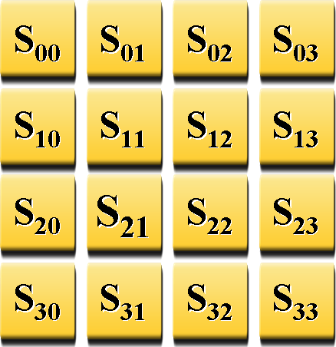


SubBytes
Nonlinear byte substitution via substitution table (S-box)
Acts independently on each byte in the current state
S'₀₀
S'₀₁
S'₀₂
S'₀₃
S-Box
S'₁₀
S'₁₁
S'₁₂
S'₁₃
S_{ij}
S’_{ij}
S'₂₀
S'₂₂
S'₂₃
SubBytes
S'₃₀
S'₃₁
S'₃₂
S'₃₃

Slide 34
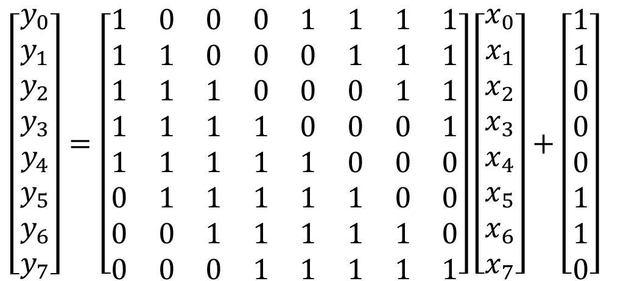
SubBytes
Process of replacing byte x in SubBytes:
  Determine the inverse element x⁻¹ (Binary form is {x₇x₆x₅x₄x₃x₂x₁x₀}), with {00}⁻¹ = {00}
  Affine: y_{i}=x_{i} ⊕ x_{(i+4) mod 8} ⊕ x_{(i+5) mod 8} ⊕ x_{(i+6) mod 8} ⊕ x_{(i+7) mod 8} ⊕ c_{i}
  with {c₇c₆c₅c₄c₃c₂c₁c₀} = {63}
$$\left[\begin{matrix}y_{0} \\ y_{1} \\ y_{2} \\ y_{3} \\ y_{4} \\ y_{5} \\ y_{6} \\ y_{7}\end{matrix}\right]=\left[\begin{matrix}1 & 0 & 0 & 0 & 1 & 1 & 1 & 1 \\ 1 & 1 & 0 & 0 & 0 & 1 & 1 & 1 \\ 1 & 1 & 1 & 0 & 0 & 0 & 1 & 1 \\ 1 & 1 & 1 & 1 & 0 & 0 & 0 & 1 \\ 1 & 1 & 1 & 1 & 1 & 0 & 0 & 0 \\ 0 & 1 & 1 & 1 & 1 & 1 & 0 & 0 \\ 0 & 0 & 1 & 1 & 1 & 1 & 1 & 0 \\ 0 & 0 & 0 & 1 & 1 & 1 & 1 & 1\end{matrix}\right]\left[\begin{matrix}x_{0} \\ x_{1} \\ x_{2} \\ x_{3} \\ x_{4} \\ x_{5} \\ x_{6} \\ x_{7}\end{matrix}\right]+\left[\begin{matrix}1 \\ 1 \\ 0 \\ 0 \\ 0 \\ 1 \\ 1 \\ 0\end{matrix}\right]$$

Slide 35
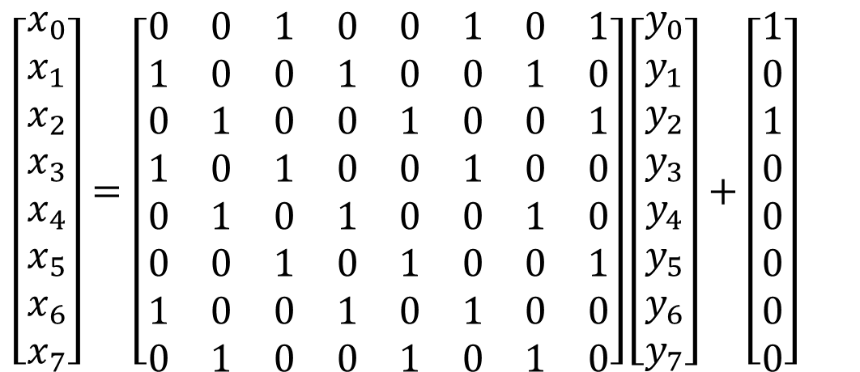
InvSubBytes
Process of replacing byte y in InvSubBytes:
Affine:
  x_{i} = y_{(i+2) mod 8} ⊕ y_{(i+5) mod 8} ⊕ y_{(i+7) mod 8} ⊕ d_{i} với {d₇d₆d₅d₄d₃d₂d₁d₀} = {05}
Determine the inverse element x⁻¹∈ GF(2⁸) of x ({00}⁻¹ = {00})
$$\left[\begin{matrix}x_{0} \\ x_{1} \\ x_{2} \\ x_{3} \\ x_{4} \\ x_{5} \\ x_{6} \\ x_{7}\end{matrix}\right]=\left[\begin{matrix}0 & 0 & 1 & 0 & 0 & 1 & 0 & 1 \\ 1 & 0 & 0 & 1 & 0 & 0 & 1 & 0 \\ 0 & 1 & 0 & 0 & 1 & 0 & 0 & 1 \\ 1 & 0 & 1 & 0 & 0 & 1 & 0 & 0 \\ 0 & 1 & 0 & 1 & 0 & 0 & 1 & 0 \\ 0 & 0 & 1 & 0 & 1 & 0 & 0 & 1 \\ 1 & 0 & 0 & 1 & 0 & 1 & 0 & 0 \\ 0 & 1 & 0 & 0 & 1 & 0 & 1 & 0\end{matrix}\right]\left[\begin{matrix}y_{0} \\ y_{1} \\ y_{2} \\ y_{3} \\ y_{4} \\ y_{5} \\ y_{6} \\ y_{7}\end{matrix}\right]+\left[\begin{matrix}1 \\ 0 \\ 1 \\ 0 \\ 0 \\ 0 \\ 0 \\ 0\end{matrix}\right]$$

Slide 36
ShiftRows
shift(r, Nb) |  | r
 |  | 1 | 2 | 3
Nb | 4 | 1 | 2 | 3
 | 6 | 1 | 2 | 3
 | 8 | 1 | 3 | 4
Each line of the current state is rotated by a number of places
Byte s_{r,c} at row r column c changes to column (c + shift(r, Nb)) mod Nb
InvShiftRows: Byte s_{r,c} at row r column c changes to column (c- shift(r, Nb)) mod Nb
ShiftRows

Slide 37
AddRoundKey
Each byte of the status will XOR with corresponding byte in key-cipher of the current cycle: s’_{r,c} = k_{r,c} ⊕ s_{r,c} , 0 ≤ r < 4, 0 ≤ c < Nb
Inverse transformation of AddRoundKey is itself.
W_{l+c}
S_{0c}
S_{1c}
S_{2c}
S_{3c}
S’_{0c}
S’_{1c}
S’_{2c}
S’_{3c}
S₀₀ | S₀₁ | S₀₂ | S₀₃
S₁₀ | S₁₁ | S₁₂ | S₁₃
S₂₀ | S₂₁ | S₂₂ | S₂₃
S₃₀ | S₃₁ | S₃₂ | S₃₃
W_{l} | W_{l+1} | W_{l+2} | W_{l+3}
S'₀₀ | S'₀₁ | S'₀₂ | S'₀₃
S'₁₀ | S'₁₁ | S'₁₂ | S'₁₃
S'₂₀ | S'₂₁ | S'₂₂ | S'₂₃
S'₃₀ | S'₃₁ | S'₃₂ | S'₃₃
⊕
=
l = round*Nb

Slide 38
MixColumns
S₀₀
S_{i}
S₀₁
S₀₂
S₀₃
S’_{i}
S'₀₀
S'₀₁
S'₀₂
S'₀₃
S₁₀
S₁₁
S₁₂
S₁₃
_{⊗a(x)}
S'₁₀
S'₁₁
S'₁₂
S'₁₃
S₂₀
S₂₁
S₂₂
S₂₃
S'₂₀
S'₂₁
S'₂₂
S'₂₃
S₃₀
S₃₁
S₃₂
S₃₃
MixColumns
S'₃₀
S'₃₁
S'₃₂
S'₃₃

Slide 39
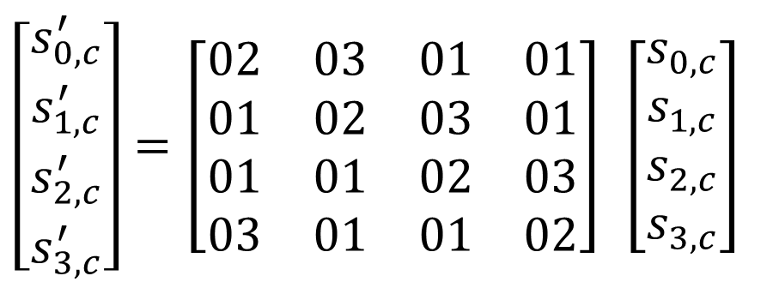
MixColumns
Each column of the current state is represented as a polynomial s(x) with coefficients in GF(2⁸).
Perform multiplication: s’(x) = a(x) ⊗ s(x)
With: a(x) = {03}x³+{01}x²+{01}x+{02}
$$\begin{matrix}\left[\begin{matrix}s_{0,c}^{′} \\ s_{1,c}^{′} \\ s_{2,c}^{′} \\ s_{3,c}^{′}\end{matrix}\right]\end{matrix}=\left[\begin{matrix}02 & 03 & 01 & 01 \\ 01 & 02 & 03 & 01 \\ 01 & 01 & 02 & 03 \\ 03 & 01 & 01 & 02\end{matrix}\right] \left[\begin{matrix}s_{0,c} \\ s_{1,c} \\ s_{2,c} \\ s_{3,c}\end{matrix}\right]$$

Slide 40
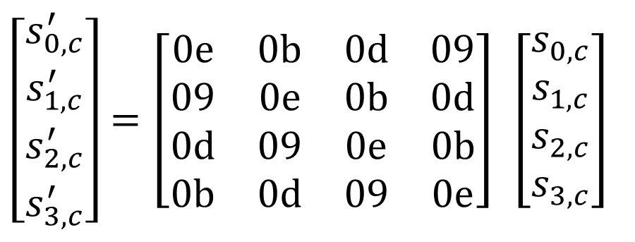
InvMixColumns
Each column of the current state is represented as a polynomial s(x) with coefficients in GF(2⁸).
Perform multiplication: s’(x) = a⁻¹(x) ⊗ s(x)
With: a⁻¹(x) = {0b}x³+{0d}x²+{09}x+{0e}
$$\begin{matrix}\left[\begin{matrix}s_{0,c}^{′} \\ s_{1,c}^{′} \\ s_{2,c}^{′} \\ s_{3,c}^{′}\end{matrix}\right]\end{matrix}=\left[\begin{matrix}0e & 0b & 0d & 09 \\ 09 & 0e & 0b & 0d \\ 0d & 09 & 0e & 0b \\ 0b & 0d & 09 & 0e\end{matrix}\right] \left[\begin{matrix}s_{0,c} \\ s_{1,c} \\ s_{2,c} \\ s_{3,c}\end{matrix}\right]$$

Slide 41
Generate a key-cipher for each cycle
The extended key table is a 1-dimensional array of words (4 bytes in length).
Function that generates the extended key cipher table depends on the value Nk, that is, on the length of the primary key
4 bytes
w₀ | w₁ | w₂ | w₃ | w₄ | w₅ | w₆ | w₇ | w₈ | w₉ | w₁₀ | w₁₁ | w₁₂ | w₁₃ | w₁₄ | w₁₅ | w₁₆ | w₁₇ | …
Key for cycle 0 |  |  |  |  |  | Key for cycle 1 |  |  |  |  |  | Key for cycle 2 |  |  |  |  |  | …
Extended key cipher table and how to determine
key of the period (Nb = 6 (192-bit data), Nk = 4 (128-bit key))

Slide 42
Generate a key-cipher for each cycle
KeyExpansion(byte key[4 * Nk], word w[Nb * (Nr + 1)], Nk)
begin
i=0
while (i < Nk)
w[i] = word[key[4*i], key[4*i+1], key[4*i+2],key[4*i+3]]
i = i + 1
end while
i = Nk
while (i < Nb * (Nr + 1))
word temp = w[i - 1]
if (i mod Nk = 0) then
temp = SubWord(RotWord(temp)) xor Rcon[i / Nk]
else
if (Nk = 8) and (i mod Nk = 4) then temp = SubWord(temp)
end if
w[i] = w[i - Nk] xor temp
i = i + 1
end while
end

Slide 43
Generate a key-cipher for each cycle
The set of constants is generated according to the following rule
  Rcon[i] = (RC[i], {00}, {00}, {00}) với RC[i] ∈ GF(2⁸)
  RC[i] = {02} • RC[i - 1] = x^{(i – 1)}
  Example
    Rcon[1] = (x⁰ = {01}, {00}, {00}, {00})
    Rcon[2] = (x¹ = {02}, {00}, {00}, {00})
    Rcon[3] = (x² = {04}, {00}, {00}, {00})
    …
    Rcon[8] = (x⁷ = {80}, {00}, {00}, {00})
    Rcon[9] = (x⁸ = {1B}, {00}, {00}, {00})
      Explain: x⁸ = {100000000} mod x⁸ + x⁴ + x³ + x + 1 = {100011011} = {1B}
    Rcon[10] = (x⁹ = {36}, {00}, {00}, {00})
      Explain: x⁹ = {1000000000} mod x⁸ + x⁴ + x³ + x + 1 = {100011011} = {36}
    …

Slide 44
S-box
Sbox |  | y
 |  | 0 | 1 | 2 | 3 | 4 | 5 | 6 | 7 | 8 | 9 | a | b | c | d | e | f
x | 0 | 63 | 7c | 77 | 7b | f2 | 6b | 6f | c5 | 30 | 01 | 67 | 2b | fe | d7 | ab | 76
 | 1 | ca | 82 | c9 | 7d | fa | 59 | 47 | f0 | ad | d4 | a2 | af | 9c | a4 | 72 | c0
 | 2 | b7 | fd | 93 | 26 | 36 | 3f | f7 | cc | 34 | a5 | e5 | f1 | 71 | d8 | 31 | 15
 | 3 | 04 | c7 | 23 | c3 | 18 | 96 | 05 | 9a | 07 | 12 | 80 | e2 | eb | 27 | b2 | 75
 | 4 | 09 | 83 | 2c | 1a | 1b | 6e | 5a | a0 | 52 | 3b | d6 | b3 | 29 | e3 | 2f | 84
 | 5 | 53 | d1 | 00 | ed | 20 | fc | b1 | 5b | 6a | cb | be | 39 | 4a | 4c | 58 | cf
 | 6 | d0 | ef | aa | fb | 43 | 4d | 33 | 85 | 45 | f9 | 02 | 7f | 50 | 3c | 9f | a8
 | 7 | 51 | a3 | 40 | 8f | 92 | 9d | 38 | f5 | bc | b6 | da | 21 | 10 | ff | f3 | d2
 | 8 | cd | 0c | 13 | ec | 5f | 97 | 44 | 17 | c4 | a7 | 7e | 3d | 64 | 5d | 19 | 73
 | 9 | 60 | 81 | 4f | dc | 22 | 2a | 90 | 88 | 46 | ee | b8 | 14 | de | 5e | 0b | db
 | a | e0 | 32 | 3a | 0a | 49 | 06 | 24 | 5c | c2 | d3 | ac | 62 | 91 | 95 | e4 | 79
 | b | e7 | c8 | 37 | 6d | 8d | d5 | 4e | a9 | 6c | 56 | f4 | ea | 65 | 7a | ae | 08
 | c | ba | 78 | 25 | 2e | 1c | a6 | b4 | c6 | e8 | dd | 74 | 1f | 4b | bd | 8b | 8a
 | d | 70 | 3e | B5 | 66 | 48 | 03 | f6 | 0e | 61 | 35 | 57 | b9 | 86 | c1 | 1d | 9e
 | e | e1 | f8 | 98 | 11 | 69 | d9 | 8e | 94 | 9b | 1e | 87 | e9 | ce | 55 | 28 | df
 | f | 8c | a1 | 89 | 0d | Bf | e6 | 42 | 68 | 41 | 99 | 2d | 0f | b0 | 54 | bb | 16

Slide 45
S-Box⁻¹
Sbox⁻¹ |  | y
 |  | 0 | 1 | 2 | 3 | 4 | 5 | 6 | 7 | 8 | 9 | a | b | c | d | e | f
x | 0 | 52 | 09 | 6a | d5 | 30 | 36 | a5 | 38 | bf | 40 | a3 | 9e | 81 | f3 | d7 | fb
 | 1 | 7c | e3 | 39 | 82 | 9b | 2f | ff | 87 | 34 | 8e | 43 | 44 | c4 | de | e9 | cb
 | 2 | 54 | 7b | 94 | 32 | a6 | c2 | 23 | 3d | ee | 4c | 95 | 0b | 42 | fa | c3 | 4e
 | 3 | 08 | 2e | a1 | 66 | 28 | d9 | 24 | b2 | 76 | 5b | a2 | 49 | 6d | 8b | d1 | 25
 | 4 | 72 | f8 | f6 | 64 | 86 | 68 | 98 | 16 | d4 | a4 | 5c | cc | 5d | 65 | b6 | 92
 | 5 | 6c | 70 | 48 | 50 | fd | ed | b9 | da | 5e | 15 | 46 | 57 | a7 | 8d | 9d | 84
 | 6 | 90 | d8 | ab | 00 | 8c | bc | d3 | 0a | f7 | e4 | 58 | 05 | b8 | b3 | 45 | 06
 | 7 | d0 | 2c | 1e | 8f | ca | 3f | 0f | 02 | c1 | af | bd | 03 | 01 | 13 | 8a | 6b
 | 8 | 3a | 91 | 11 | 41 | 4f | 67 | dc | ea | 97 | f2 | cf | ce | f0 | b4 | e6 | 73
 | 9 | 96 | ac | 74 | 22 | e7 | ad | 35 | 85 | e2 | f9 | 37 | e8 | 1c | 75 | df | 6e
 | a | 47 | f1 | 1a | 71 | 1d | 29 | c5 | 89 | 6f | b7 | 62 | 0e | aa | 18 | be | 1b
 | b | fc | 56 | 3e | 4b | c6 | d2 | 79 | 20 | 9a | db | c0 | fe | 78 | cd | 5a | f4
 | c | 1f | dd | a8 | 33 | 88 | 07 | c7 | 31 | b1 | 12 | 10 | 59 | 27 | 80 | ec | 5f
 | d | 60 | 51 | 7f | a9 | 19 | b5 | 4a | 0d | 2d | e5 | 7a | 9f | 93 | c9 | 9c | ef
 | e | a0 | e0 | 3b | 4d | ae | 2a | f5 | b0 | c8 | eb | bb | 3c | 83 | 53 | 99 | 61
 | f | 17 | 2b | 04 | 7e | ba | 77 | d6 | 26 | e1 | 69 | 14 | 63 | 55 | 21 | 0c | 7d

Slide 46
Guidance of AES128
AES128(M, K) // |K| = |M| = 128 bits
  (K₀, K₁, …, K₁₀) ← expand(K) // K₀ ← K
  s ← M ⊕ K₀
  Loop r = 1 → 10
    s ← s-box(s)
    s ← shift-rows(s)
    If r ≤ 9 then s ← mix-cols(s)
    s ← s ⊕ K_{r}
  Return s
expand(K) // |K| = 128 bits
  K₀ ← K
  Loop i = 1 → 10
    K_{i}[0] ← K_{i – 1}[0] ⊕ s-box(K_{i – 1}[3] <<< 8) ⊕ C_{i}
    K_{i}[1] ← K_{i – 1}[1] ⊕ K_{i}[0]
    K_{i}[2] ← K_{i – 1}[2] ⊕ K_{i}[1]
    K_{i}[3] ← K_{i – 1}[3] ⊕ K_{i}[2]
  Return (K₀, K₁, …, K₁₀)

Slide 47
Guidance of AES128 (expand)
expand(K) // |K| = 128 bits
  K₀ ← K
  Loop i = 1 → 10
    K_{i}[0] ← K_{i – 1}[0] ⊕ s-box(K_{i – 1}[3] <<< 8) ⊕ C_{i}
    K_{i}[1] ← K_{i – 1}[1] ⊕ K_{i}[0]
    K_{i}[2] ← K_{i – 1}[2] ⊕ K_{i}[1]
    K_{i}[3] ← K_{i – 1}[3] ⊕ K_{i}[2]
  Return (K₀, K₁, …, K₁₀)
Notes:
  The input is usually a 16-byte key sequence, ví dụ “Thats my Kung Fu”
  The algorithm deals with integers, each subkey consists of 4 integers
    Each integer 4 bytes
    Use type int

Slide 48
Guidance of AES128 (expand)
expand(K) // |K| = 128 bits
  K₀ ← K
  Loop i = 1 → 10
    K_{i}[0] ← K_{i – 1}[0] ⊕ s-box(K_{i – 1}[3] <<< 8) ⊕ C_{i}
    K_{i}[1] ← K_{i – 1}[1] ⊕ K_{i}[0]
    K_{i}[2] ← K_{i – 1}[2] ⊕ K_{i}[1]
    K_{i}[3] ← K_{i – 1}[3] ⊕ K_{i}[2]
  Return (K₀, K₁, …, K₁₀)
Table of constants C:
i | Values
C₀ | 0x00000000
C₁ | 0x01000000
C₂ | 0x02000000
C₃ | 0x04000000
C₄ | 0x08000000
C₅ | 0x10000000
C₆ | 0x20000000
C₇ | 0x40000000
C₈ | 0x80000000
C₉ | 0x1b000000
C₁₀ | 0x36000000

Slide 49
Guidance of AES128 (expand)
Some notes
  Convert from 4 bytes to 1 int: char s[] = “abcd” → int a = 0x61626364
  Convert from 1 int to 4 bytes: int a = 0x61626364 → char s[] = “abcd”
  Same for transferring 16 bytes → 4 ints and 4 ints → 16 bytes
Example to test expand:
Keys | Values
K₀ | 54 68 61 74 73 20 6d 79 20 4b 75 6e 67 20 46 75
K₁ | e2 32 fc f1 91 12 91 88 b1 59 e4 e6 d6 79 a2 93
K₂ | 56 08 20 07 c7 1a b1 8f 76 43 55 69 a0 3a f7 fa
K₃ | d2 60 0d e7 15 7a bc 68 63 39 e9 01 c3 03 1e fb
K₄ | a1 12 02 c9 b4 68 be a1 d7 51 57 a0 14 52 49 5b
K₅ | b1 29 3b 33 05 41 85 92 d2 10 d2 32 c6 42 9b 69
K₆ | bd 3d c2 87 b8 7c 47 15 6a 6c 95 27 ac 2e 0e 4e
K₇ | cc 96 ed 16 74 ea aa 03 1e 86 3f 24 b2 a8 31 6a
K₈ | 8e 51 ef 21 fa bb 45 22 e4 3d 7a 06 56 95 4b 6c
K₉ | bf e2 bf 90 45 59 fa b2 a1 64 80 b4 f7 f1 cb d8
K₁₀ | 28 fd de f8 6d a4 24 4a cc c0 a4 fe 3b 31 6f 26
Thats my Kung Fu

Slide 50
Guidance of AES128 (AES128)
AES128(M, K) // |K| = |M| = 128 bits
  (K₀, K₁, …, K₁₀) ← expand(K) // K₀ ← K
  s ← M ⊕ K₀
  Loop r = 1 → 10
    s ← s-box(s)
    s ← shift-rows(s)
    if r ≤ 9 then s ← mix-cols(s)
    s ← s ⊕ K_{r}
  Return s
Notes:
  Value s: s₀s₁s₂s₃s₄s₅s₆s₇s₈s₉s₁₀s₁₁s₁₂s₁₃s₁₄s₁₅ stands for a 16-byte string (s = M ⊕ K₀)
  Function s-box: [0, 255] → [0, 255] follows S-box table

Slide 51
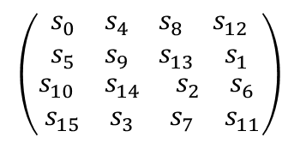
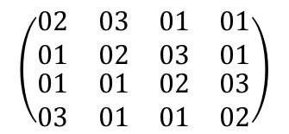
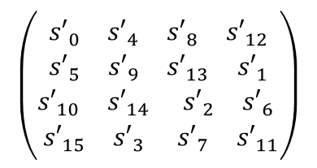
Guidance of AES128 (AES128)
AES128(M, K) // |K| = |M| = 128 bits
  (K₀, K₁, …, K₁₀) ← expand(K) // K₀ ← K
  s ← M ⊕ K₀
  Loop r = 1 → 10
    s ← s-box(s)
    s ← shift-rows(s)
    if r ≤ 9 then s ← mix-cols(s)
    s ← s ⊕ K_{r}
  Return s
Notes:
  shift-rows
    Input: s₀s₁s₂s₃s₄s₅s₆s₇s₈s₉s₁₀s₁₁s₁₂s₁₃s₁₄s₁₅
    Output: s₀s₅s₁₀s₁₅s₄s₉s₁₄s₃s₈s₁₃s₂s₇s₁₂s₁s₆s₁₁
$$\left(\begin{matrix}\begin{matrix}\begin{matrix}{s′}_{0} & {s′}_{4}\end{matrix} & \begin{matrix}{s′}_{8} & {s′}_{12}\end{matrix} \\ \begin{matrix}{s′}_{5} & {s′}_{9}\end{matrix} & \begin{matrix}{s′}_{13} & {s′}_{1}\end{matrix}\end{matrix} \\ \begin{matrix}\begin{matrix}{s′}_{10} & {s′}_{14}\end{matrix} & \begin{matrix}{s′}_{2} & {s′}_{6}\end{matrix} \\ \begin{matrix}{s′}_{15} & {s′}_{3}\end{matrix} & \begin{matrix}{s′}_{7} & {s′}_{11}\end{matrix}\end{matrix}\end{matrix}\right)$$
$$\left(\begin{matrix}\begin{matrix}\begin{matrix}02 & 03\end{matrix} & \begin{matrix}01 & 01\end{matrix} \\ \begin{matrix}01 & 02\end{matrix} & \begin{matrix}03 & 01\end{matrix}\end{matrix} \\ \begin{matrix}\begin{matrix}01 & 01\end{matrix} & \begin{matrix}02 & 03\end{matrix} \\ \begin{matrix}03 & 01\end{matrix} & \begin{matrix}01 & 02\end{matrix}\end{matrix}\end{matrix}\right)$$
⊗
$$\left(\begin{matrix}\begin{matrix}\begin{matrix}s_{0} & s_{4}\end{matrix} & \begin{matrix}s_{8} & s_{12}\end{matrix} \\ \begin{matrix}s_{5} & s_{9}\end{matrix} & \begin{matrix}s_{13} & s_{1}\end{matrix}\end{matrix} \\ \begin{matrix}\begin{matrix}s_{10} & s_{14}\end{matrix} & \begin{matrix}s_{2} & s_{6}\end{matrix} \\ \begin{matrix}s_{15} & s_{3}\end{matrix} & \begin{matrix}s_{7} & s_{11}\end{matrix}\end{matrix}\end{matrix}\right)$$

Slide 52
Guidance of AES128 (AES128)
Test-vector for AES128
  Key: 54|68|61|74|73|20|6d|79|20|4b|75|6e|67|20|46|75 (“Thats my Kung Fu”)
  Message: 54|77|6f|20|4f|6e|65|20|4e|69|6e|65|20|54|77|6f (“Two One Nine Two”)
  Cipher-text:
    C₀: 00 1f 0e 54 3c 4e 08 59 6e 22 1b 0b 47 74 31 1a
    C₁: 58 47 08 8b 15 b6 1c ba 59 d4 e2 e8 cd 39 df ce
    C₂: 43 c6 a9 62 0e 57 c0 c8 09 08 eb fe 3d f8 7f 37
    C₃: 78 76 30 54 70 76 7d 23 99 3c 37 5b 4b 39 34 f1
    C₄: b1 ca 51 ed 08 fc 54 e1 04 b1 c9 d3 e7 b2 6c 20
    C₅: 9b 51 20 68 23 5f 22 f0 5d 1c bd 32 2f 38 91 56
    C₆: 14 93 25 77 8f a4 2b e8 c0 60 24 40 5e 0f 92 75
    C₇: 53 39 8e 5d 43 06 93 f8 4f 0a 3b 95 85 52 57 bd
    C₈: 66 25 3c 74 70 ce 5a a8 af d3 0f 0a a3 73 13 54
    C₉: 09 66 8b 78 a2 d1 9a 65 f0 fc e6 c4 7b 3b 30 89
    C₁₀: 29 c3 50 5f 57 14 20 f6 40 22 99 b3 1a 02 d7 3a
Intermediate cipher-text of AES128
Final cipher-text of AES128

Slide 53
Contents
Modes of Operation
Padding Schemes

Slide 54
Modes of Operation
In cryptography, data is often divided into chunks of fixed size (e.g., 64 or 128 bits).
To encrypt the long messages (split into multiple blocks), modes of operation can be used.
Some modes of operation (ECB, CBC, OFB, CFB) provide confidentiality, but do not ensure message integrity
Some modes of operation (CCM, EAX and OCB) ensure confidentiality and message integrity.
Some modes of operation are designed to encrypt sector on disc:
  Tweakable narrow-block encryption –LRW
  Wide-block encryption -CMC and EME

Slide 55
Electronic codebook (ECB)
Simple mode of operation is electronic codebook (ECB)
The message to be encrypted is divided into segments, each segment is encrypted independently.
Limitation: blocks with the same content, after encryption, also form identical result blocks → do not hide data pattern.
The use of ECB in cryptographic protocols is not recommended

Slide 56
Electronic codebook (ECB)
Plaintext
Plaintext
Plaintext
Key
Block Cipher
Encryption
Key
Block Cipher
Encryption
Key
Block Cipher
Encryption
Ciphertext
Ciphertext
Ciphertext
Electronic Codebook (ECB) mode encryption

Slide 57
Electronic codebook (ECB)
Ciphertext
Ciphertext
Ciphertext
Key
Block Cipher
Decryption
Key
Block Cipher
Decryption
Key
Block Cipher
Decryption
Plaintext
Plaintext
Plaintext
Electronic Codebook (ECB) mode decryption

Slide 58



Electronic codebook (ECB)
ECB can make the protocol less secure to protect information integrity (for example of replay attacks)
Original image | Encrypt with ECB | Encrypt with others

Slide 59
Cipher-block chaining (CBC)
In cipher-block chaining (CBC):
  Each plaintext block is XORed with the ciphertext block before being encrypted.
  Thus, each ciphertext block depends on all the plaintext blocks that appear from the beginning up to that point
  To ensure the uniqueness of each encrypted message, we use an additional initialization vector

Slide 60
Cipher-block chaining (CBC)
C₀ = IV
C_{i} = E_{K} (P_{i} ⊕ C_{i – 1})
Initialization vector (IV)
Plaintext
Plaintext
Plaintext
⊕
⊕
⊕
Key
Block Cipher
Encryption
Key
Block Cipher
Encryption
Key
Block Cipher
Encryption
Ciphertext
Ciphertext
Ciphertext
Cipher Block Chaining (CBC) mode encryption

Slide 61
Cipher-block chaining (CBC)
C₀ = IV
P_{i} = D_{K} (C_{i} ) ⊕ C_{i – 1}
Initialization vector (IV)
Ciphertext
Ciphertext
Ciphertext
Key
Block Cipher
Decryption
Key
Block Cipher
Decryption
Key
Block Cipher
Decryption
⊕
⊕
⊕
Plaintext
Plaintext
Plaintext
Cipher Block Chaining (CBC) mode decryption

Slide 62
Propagating cipher-block chaining (PCBC)
CBC is the most commonly-used type.
Limitation: sequential processing, cannot be parallelized: counter mode solution can be chosen for parallel processing
Propagating cipher-block chaining is designed to allow the influence is more pervasive in CBC.
  P₀ = IV, C₀ = 0, C_{i} = E_{K} ( P_{i} ⊕ P_{i – 1} ⊕ C_{i – 1})
  P₀ = IV, C₀ = 0, P_{i} = D_{K} (C_{i} ) ⊕ P_{i – 1} ⊕ C_{i – 1}
PCBC commonly used in Kerberos and WASTE (besides, it's less common!)

Slide 63
Cipher feedback (CFB)
C₀ = IV
C_{i} = P_{i} ⊕ E_{K} (C_{i – 1})
Properties:
  Plaintext is NOT encrypted by the algorithm in question
  Plaintext is encrypted by XORing a string generated by the encryption algorithm.
  Turn block-cipher into stream cipher
Initialization vector (IV)
Key
Block Cipher
Encryption
Key
Block Cipher
Encryption
Key
Block Cipher
Encryption
Plaintext
Plaintext
Plaintext
⊕
⊕
⊕
Ciphertext
Ciphertext
Ciphertext
Cipher Feedback (CFB) mode encryption

Slide 64
Cipher feedback (CFB)
Initialization vector (IV)
Key
Block Cipher
Encryption
Key
Block Cipher
Encryption
Key
Block Cipher
Encryption
⊕
⊕
⊕
Ciphertext
Ciphertext
Ciphertext
Plaintext
Plaintext
Plaintext
Cipher Feedback (CFB) mode decryption

Slide 65
Output feedback (OFB)
O₀ = IV
O_{i} = E_{K} (O_{i – 1})
C_{i} = P_{i} ⊕ O_{i}
Properties:
  Plaintext is NOT encrypted by the algorithm in question
  Plaintext is encrypted by XORing a string generated by the encryption algorithm.
  Turn block-cipher into stream cipher
Initialization vector (IV)
Key
Block Cipher
Encryption
Key
Block Cipher
Encryption
Key
Block Cipher
Encryption
Plaintext
Plaintext
Plaintext
⊕
⊕
⊕
Ciphertext
Ciphertext
Ciphertext
Output Feedback (OFB) mode encryption

Slide 66
Output feedback (OFB)
O₀ = IV
O_{i} = E_{K} (O_{i – 1})
P_{i} = C_{i} ⊕ O_{i}
Initialization vector (IV)
Key
Block Cipher
Encryption
Key
Block Cipher
Encryption
Key
Block Cipher
Encryption
⊕
⊕
⊕
Ciphertext
Ciphertext
Ciphertext
Plaintext
Plaintext
Plaintext
Ouput Feedback (OFB) mode decryption

Slide 67
Counter (CTR)
CTR is called Segmented Integer Counter (SIC)
Similar to OFB, Counter converts block cipher to stream cipher.
  Create next block keystream by encrypting next value of “counter”.
Counter can be any function generating a string of distinct numbers in a long-enough duration.
CTR has properties similar to OFC,
CTR allows to randomly decrypt any cipher-text block
Note: Role of nonce is the same as initialization vector (IV)
IV/nonce and value counter can be joined, added or XORed to create a unique string of bits corresponding to each value counter

Slide 68
Counter (CTR)
Nonce
c59bcf35…
Counter
00000000
Nonce
c59bcf35…
Counter
00000001
Nonce
c59bcf35…
Counter
00000002
Key
Block Cipher
Encryption
Key
Block Cipher
Encryption
Key
Block Cipher
Encryption
⊕
⊕
⊕
Plaintext
Plaintext
Plaintext
Ciphertext
Ciphertext
Ciphertext
Counter (CTR) mode encryption

Slide 69
Counter (CTR)
Nonce
c59bcf35…
Counter
00000000
Nonce
c59bcf35…
Counter
00000001
Nonce
c59bcf35…
Counter
00000002
Key
Block Cipher
Encryption
Key
Block Cipher
Encryption
Key
Block Cipher
Encryption
⊕
⊕
⊕
Ciphertext
Ciphertext
Ciphertext
Plaintext
Plaintext
Plaintext
Counter (CTR) mode decryption

Slide 70
Error propagation
Limiting error-propagation: a criterion for evaluating Mode of operation
Example: investigate error-propagation when decrypting information with CBC
Initialization vector (IV)
Flipped ciphertext bits
Ciphertext
Ciphertext
Ciphertext
Key
Block Cipher
Decryption
Key
Block Cipher
Decryption
Key
Block Cipher
Decryption
⊕
⊕
⊕
Garbled decryption
Plaintext
Plaintext
Plaintext
Flipped plaintext bits
Modification attack or transmission error for CBC

Slide 71
Initialization vector (IV)
All modes of operation (except ECB) use initialization vector - IV.
Role of IV:
  Dummy block so that the processing of the first block is not different from the processing of successive blocks
  Increase the randomness of the encryption process.
  No need to keep it a secret
  Be sure to limit the reuse of the same IV value with the same key.
With CBC and CFB, reusing IV values ​​leaks information.
With OFB and CTR, reusing the IV completely breaks the security of the system
IV in CFB must be randomly generated and kept secret until the contents of the first plaintext block are ready for encryption

Slide 72
Padding schemes
Padding Scheme: additional information so that the data block is the right size for encryption
Requirements:
  Data block after addition has a size suitable for encryption
  Can easily recover the exact data after decryption (exactly cut off the extra data)
Basic methods:
  Bit Padding: see RFC1321 (http://www.faqs.org/rfcs/rfc1321.html)
  Byte Padding: see RFC1319 (http://www.faqs.org/rfcs/rfc1319.html)

Slide 73
Padding schemes
Bit Padding:
  “Standard” data block-size: n bits
  Original data block M has size of m bits (m ≤ n)
  Data block after padding
M
1
0…0
L = n – (m mod n)
m bits
1 bit
(L – 1) bits
What if m = n?

Slide 74
Padding schemes
Byte Padding (PKCS5):
  “Standard” data block-size: n bytes (n < 256)
  Original data block M has size of m bytes (m ≤ n)
  Data block after padding
M
L … L
L = n – (m mod n)
m bytes
L bytes
What if m = n?

Slide 75
Find out more
OAEP (Optimal Asymmetric Encryption Padding)
CCM (Counter with CBC-MAC mode)
EAX (Encryption-then-Authentication-then-Translate mode)
OCB (Offset codebook mode)

Slide 76
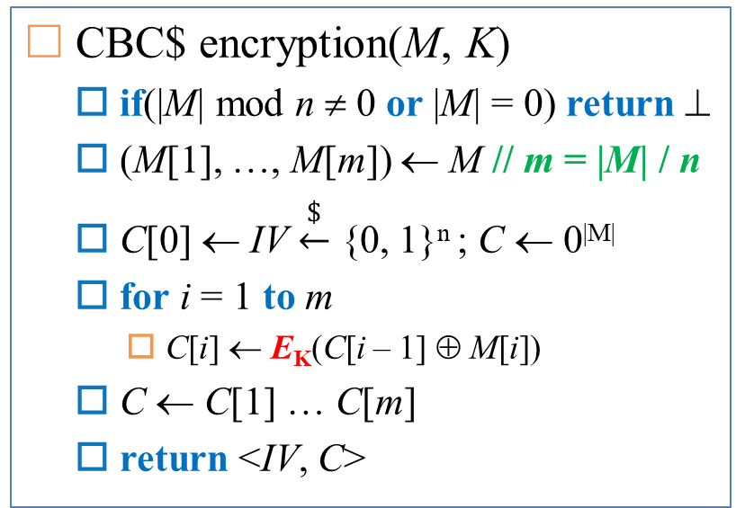
Exercise
CBC$ encryption(M, K)
  if(|M| mod n ≠ 0 or |M| = 0) return ⊥
  (M[1], …, M[m]) ← M // m = |M| / n
  C[0] ← IV $\underset{←}{\$}$ {0, 1}^{n} ; C ← 0^{|M|}
  for i = 1 to m
    C[i] ← E_{K}(C[i – 1] ⊕ M[i])
  C ← C[1] … C[m]
  return <IV, C>
CBC$ decryption(<IV, C>, K)
  if(|C| mod n ≠ 0 or |C| = 0) return ⊥
  (C[1], …, C[m]) ← C // m = |C| / n
  C[0] ← IV ; M ← 0^{|C|}
  for i = 1 to m
    M[i] ← D_{K}(C[i ] ⊕ C[i – 1])
  M ← M[1] … M[m]
  return M

